Slide 1
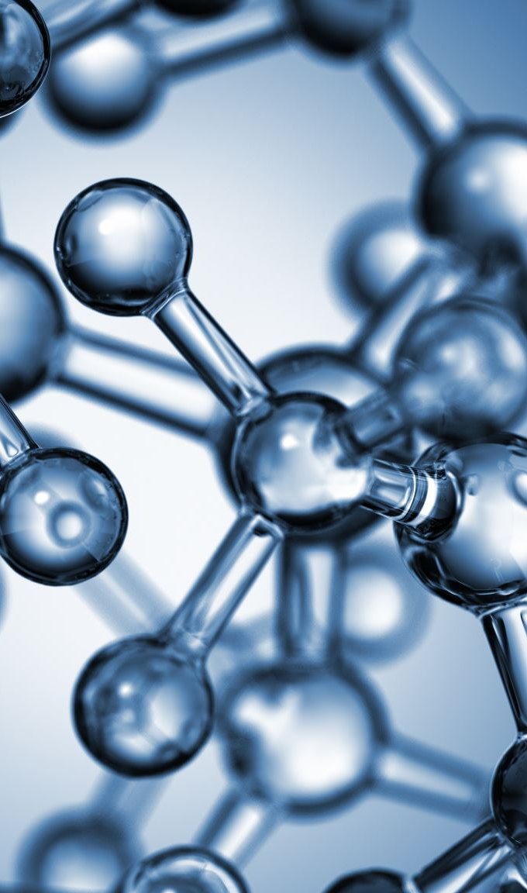
Prediction of Molecule Interactions
Gurunadh Parinandi
October 28, 2020

Slide 2
MOTIVATION
Pharmaceutical Industry had an economic output of $1.3 Trillion Dollars in 2015.
Molecule interactions are used to predict new drugs.
Drug Repurposing.
Understanding molecule interactions is useful in the field of bioenergy.
Molecule Interactions have given way to new computer algorithms and techniques in Data Science (high throughput sequencing).
OBJECTIVE
Given it’s chemical properties, predict if a molecule binds to a known target site using known Machine Learning Algorithms.
Understand what features are most important in predicting if a molecule binds to a target site.

Slide 3
Methodology
Utilized ChEMBL database of known bioactive molecules (https://www.ebi.ac.uk/chembl).
6,900 Compounds
9,800 Activities.
Database size is 1.5 GB
Library of Academic Papers that utilized database.
Created personal PostgreSQL database to store data.
Had to utilize SQL schema to create working dataset.
Data curation took more time than I originally anticipated.
Logistic Regression used for both prediction and inference.

Slide 4
Information on FEATURES USED IN ANALYSIS
19 features total were used in analysis.
Drug Interaction is Target Feature:
1 if molecule is known to bind to target site. 0 if molecule does not bind to target site, or molecule interaction is not known.
Molregno is the unique identifier given to each molecule.
Some of the features used :
Aromatic Rings - Number of Aromatic Rings.
PSA – Polar Surface Area
Full Mwt – Full Molecular Weight including salts.
HBA_Lipinkski – Number of Hydrogen Bond Acceptors according to Lipinski Rules.
HBD Donors – Number of Hydrogen Bond Donors according to Lipinski Rules.
Full Dictionary located at: http://ftp.ebi.ac.uk/pub/databases/chembl/ChEMBLdb/releases/chembl_23/schema_documentation.html

Slide 5
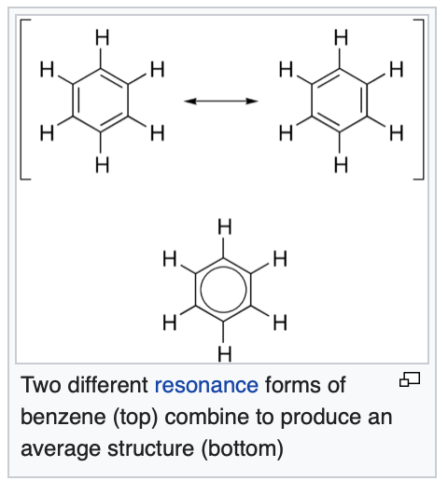
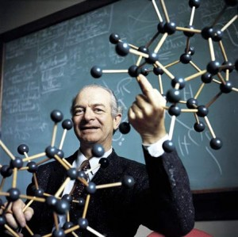
INFERENCE FROM LOGISTIC REGRESSION MODEL
Aromatic Rings feature with largest norm in molecule prediction with target:
Cyclic property of molecule to increase molecular stability
Attr to Pi-BONDS.
Other important features include HBA/HBP LIPINSKI

Slide 6
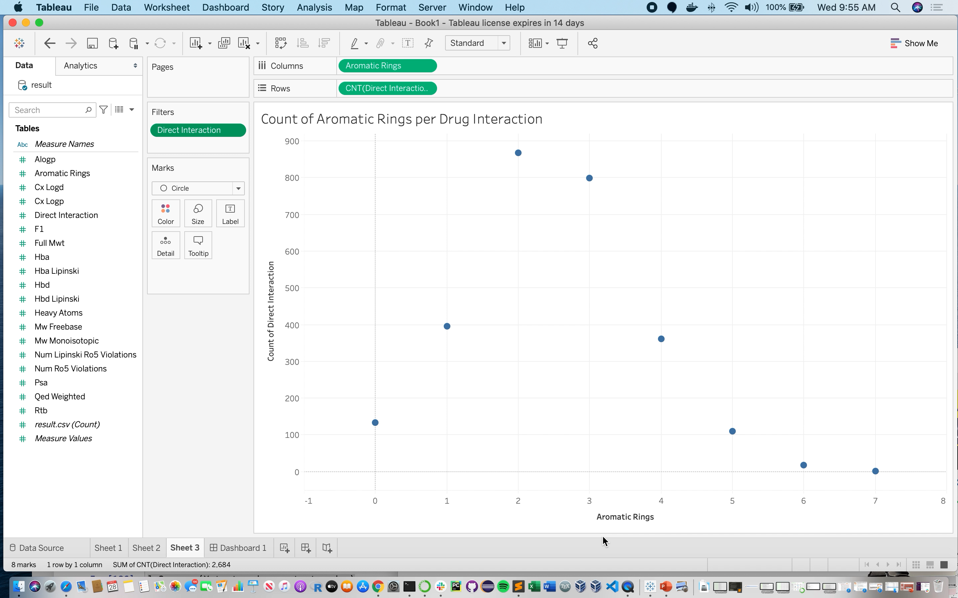
TABLEAU-# OF DRUG INTERACTIONS vs. # Aromatic rings.

Slide 7
NEXT STEPS
Finish modeling of Drug Interactions using Test/Train/Validate method (will be done for Code Review Deadline).
Finish Logistic Regression vs. RandomForestClassier Compaison (will be done for Code Review Deadline).
Predict what molecules bind to which target sites (Proteins, lipids, etc……)

Slide 8
APPENDICES:

Slide 9
CLASS IMBALANCE
0 class | 1 class
1892785 | 2684
1 class is 0.014% of total data set.
Utilized random under-sampling from larger class.
Both classes had 2684 unique molecules to analyze.

Slide 10
confusion matrix:
Logistic Regression Results :
Training Error | Testing Error
0.680 | 0.688
ACTUAL CLASS
PREDICTED
CLASS
 | 0 | 1
0 | 1667 | 470
1 | 901 | 1256

